Slide 1
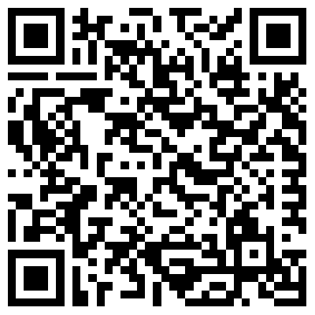
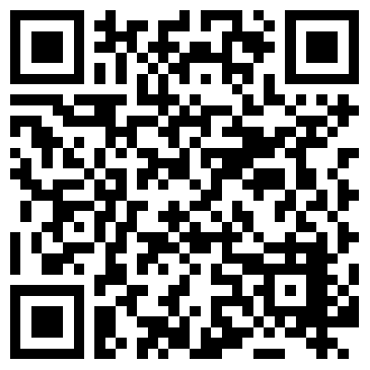
CHEMISTRY NMR SERVICE
SAMPLE SUBMISSION FORM
Name
Group
Grant or Account
Sample Code
(to match lab book)
Date
Lab
Name of compound
(if known)
Phone
Email
Structure if known
(Paste from other software
if required)
Sample Mass
Molecular mass
TUBE LENGTH MINIMUM 17.5cm
Mixture?
Solvent
Other relevant information
¹H
COSY
Shift range/Other experimental details
¹³C
HSQC
DEPT
HMBC
Install Topspin
Access Data
¹¹B
TOCSY
¹⁹F
NOESY
SOLVENT VOLUME
³¹P
ROESY
Safety and Hazard
Information
Please indicate where appropriate
if hazards are known
Carcinogenic
Poisonous
Proteopathic seeds (amyloid-beta peptide, tau protein, alpha-synuclein, TDP-43 and FUS): Please supply full details of risks involved
Toxic Vapours
Corrosive
Lachrymatory
Stench
Sample Submission: Email form as a PDF to nmr-submission@ch.cam.ac.uk
Please leave your NMR tube in the IN rack located in the cold room lobby. Ensure your tube is a Wilmad 528-PP of the correct length; non-standard tubes will not be run. Please fill in the safety information! Fill in the molecular weight and weight of sample so we can choose which instrument is best for you. Good results start with careful preparation – use the solvent volume depth guide above and avoid floating impurities. If you have a question email one of the NMR team. You can collect the tube from the OUT rack when you confirm the result is acceptable.

