Slide 1
Visitor Update A visitor is anyone who is neither an employee nor a registered student of the University of Cambridge.
Thursday 6th July 2017, 10am – 10.30am

Slide 2
Outline
Reason for visitor process review – the problem
Revised visitor process
Paperwork

Slide 3
Visitors - the problem
The University recognises the immense value of visitors.
But, there is no official record of visitors, which raises issues of:
Security: Who are they? Why are they here?
Insurance: Who is liable if there is an accident?
Intellectual Property: Who owns any results they generate?
Notes:
Kat

Slide 4
Terms and Conditions
Two sets of terms and conditions
For independent workers
For those who are coming independently, i.e. not as an employee or student of a third party company or institution (e.g. research fellows, retired staff). In this case only the visitor signs the Agreement.
For employees and students of other institutions
For those who come under the auspices of their employer or home institution. In this case, a representative of the visitor’s employer or home institution must also sign the Agreement.
Notes:
Refer to hand-outs (b) and (c).
The two sets of Standard Terms and Conditions are very similar.
The primary difference is that in (c) the Employer/Home Institution also signs up to the terms of the arrangement, and indemnifies the University against any loss or damage caused by the Visitor while they are undertaking work with the University (Standard Condition 13). Our insurers require that we obtain this so that if significant damage is caused by a Visitor they can have recourse to their employer or home institution, who in turn will claim on their insurance. Where an independent researcher comes to the University, they are still responsible to the University for their actions but the terms of condition 13 are less onerous.

Slide 5
Department of Chemistry
Largest category
Currently 47 Academic, 41 Academic Related, 135 Assistant, 224 Research staff
Currently 266 visitors in Chemistry Department – Academic, Long stay, MPhil Postgrad, PDRA, PhD Postgrad, Research Fellow, Sabbatical, Student, Other …
Every visitor to the Department of Chemistry for two weeks or more duration must sign a Visitor Agreement
The visitor cannot start work and only a temporary daily pass card will be issued until the Agreement has been signed
Visitors under two weeks duration will sign in daily and be issued with temporary daily pass cards

Slide 6
Reason for departmental review
University HR Dept updated University Visitor Process earlier this year
Need for tightening up of the departmental process; who, where and when – insurance purposes
Standard Terms and Conditions are very similar. Main difference is that the Employer and/or the home institution also signs up to the terms of the arrangement, and indemnifies the University against any loss or damage caused by the Visitor while they are undertaking work or study with the University. Our insurers require that we obtain this so that if significant damage is caused by a Visitor they can have recourse to their employer or home institution, who in turn will claim on their insurance. Where an independent researcher comes to the University, they are still responsible to the University for their actions but the terms of this condition are less onerous

Slide 7
When not to use a Visitor Agreement
A visitor agreement is not needed where the individual:
is being paid through the University (e.g. an employee or student from another UCam Department)
is acting as an external examiner or supervisor

Slide 8
Visitor Agreement Process
Prior to arriving at the Department:
Group finds out they are getting a visitor – begin Visitor Agreement Process. For non EU visitors please see Howard Jones
‘Request for information’ form emailed to visitor
Secretary to use appropriate Visitor Agreement; independent or employed
‘Your details’, ‘Special considerations’, ‘Schedule A’ and ‘Schedule B’ of the Visitor Agreement completed by secretary/group
If no associated fees, delete ‘Associate fees’ schedule B.
If no special considerations, delete [if any, see below for guidance], hyperlink and add ‘NONE’
Please keep all pages continuous
Once agreement filled in, forward to Rachael Jefferies for signatures and completion
Rachael will arrange Howard’s signature of approval, then forward Visitor Agreement to the visitor with relevant terms and conditions. Visitor will then get institution signature if required and return completed form to Rachael.

Slide 9
Paperwork required
Information request form – emailed to visitor by secretaries
Employed Visitor Agreement – information inputted by secretaries
Independent Visitor Agreement – information inputted by secretaries
Terms and Conditions; Employed or Independent - Rachael to send out

Slide 10
This will be left blank if the visitor is independently visiting

Slide 11
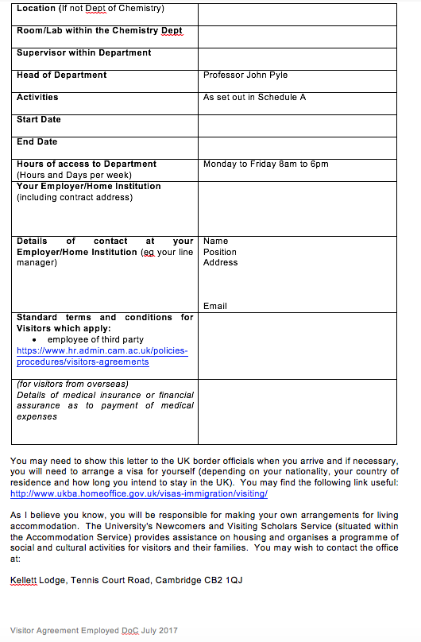
Please ensure this is complete

Slide 12
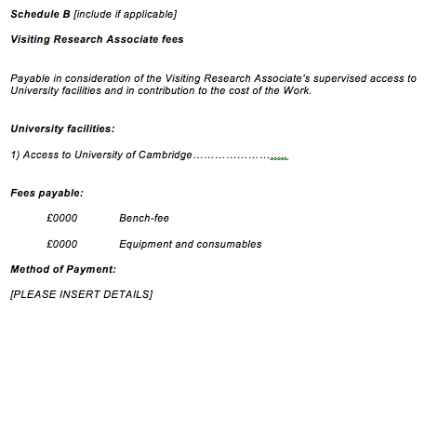
Please delete this if not applicable
Please delete this whole page if not applicable

Slide 13
Essential information
Please ensure the name of
employing institution is inserted

Slide 14
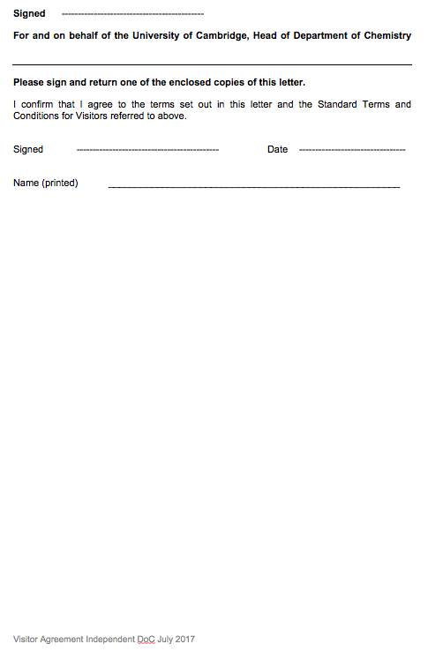
Independent Visitors
No employer/Institution needed

Slide 15
Reminders
Any type of visitor agreement must be arranged well in advance of the visitor’s arrival at the University.
Visitors must have a completed, approved and signed Visitor Agreement before they can ‘visit’ the department
Title, name, address, date must be complete
Email address must be included – primary correspondence for RJ
Highlighting should be deleted
Information not applicable should be deleted rather than crossed out
A visitor will not be allowed to commence work without the appropriate agreement in place.

